Slide 1
Convolutional Neural Networks

Slide 2
Feedforward NN

Slide 3
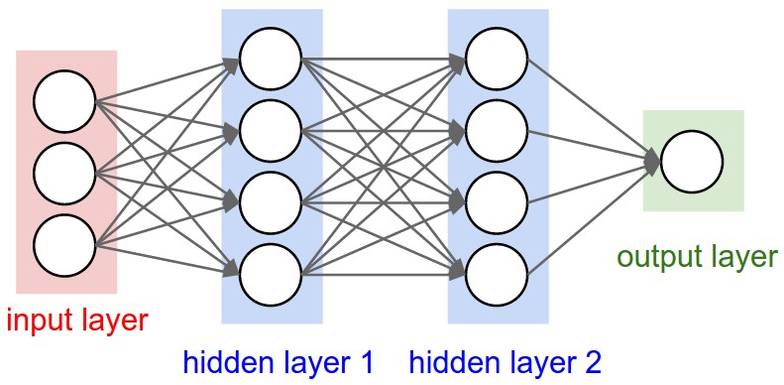
Neural Net의 구조

Slide 4
Neural Network

Slide 5
Neural Network

Slide 6
Neural Network

Slide 7
Neural Network

Slide 8
Neural Network
1
2

Slide 9
Neural Network
1
2

Slide 10
Convolutional NN

Slide 11
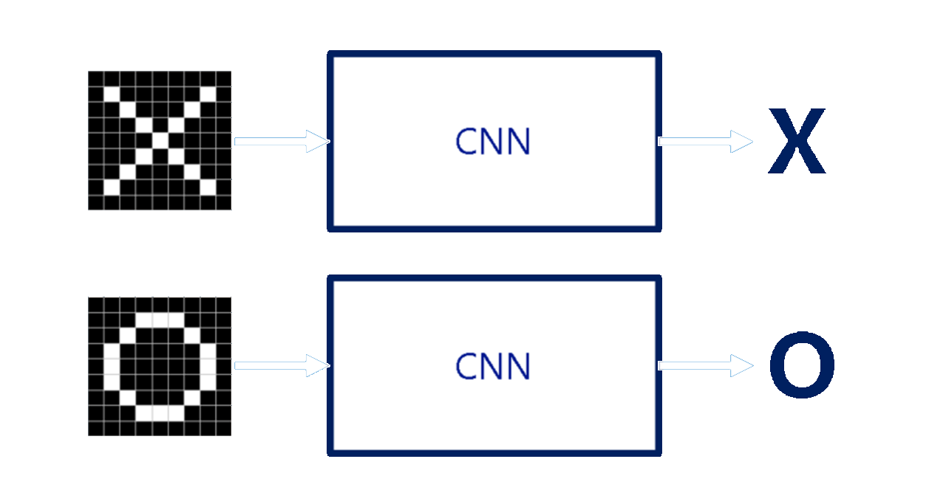

Slide 12
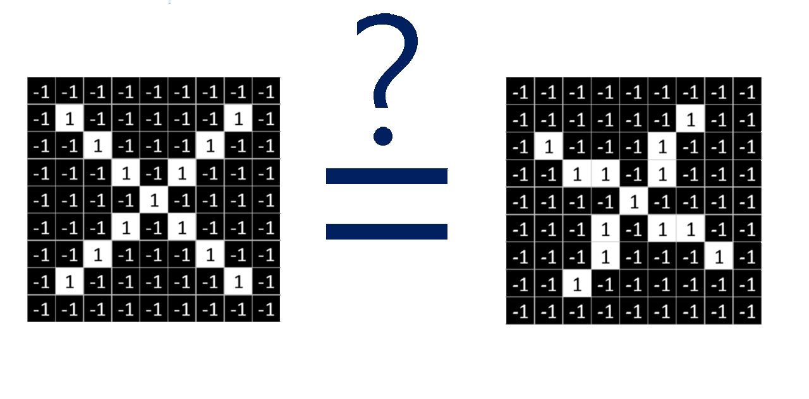

Slide 13
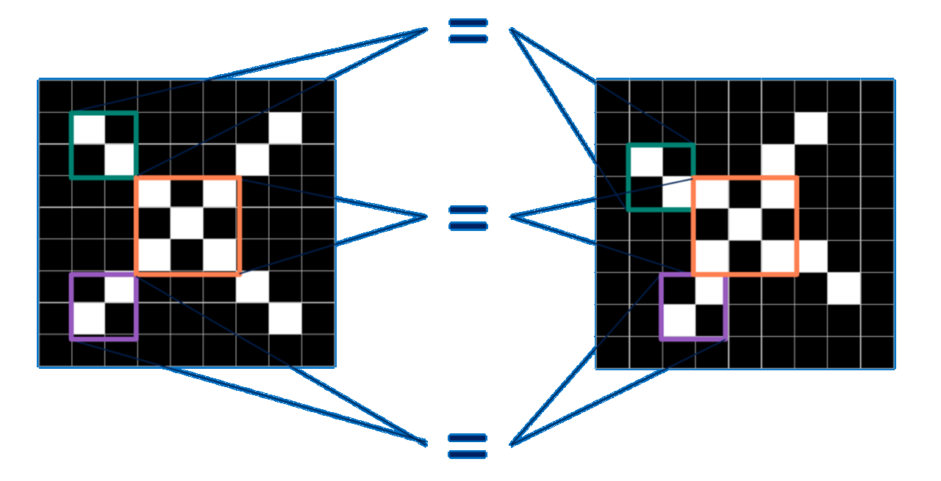

Slide 14
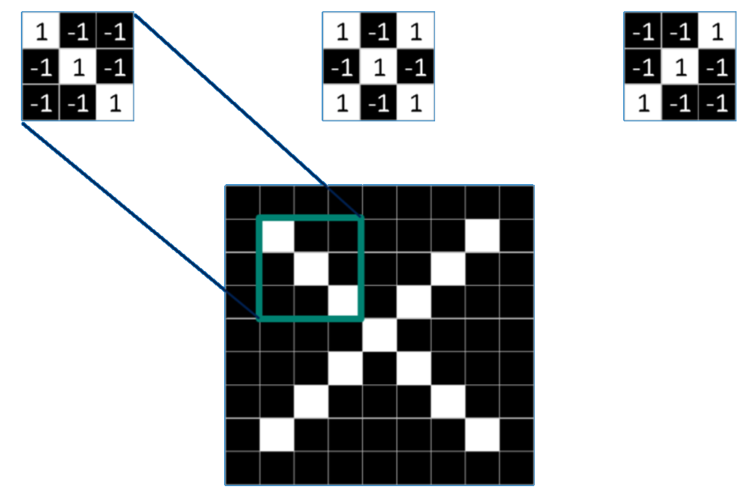

Slide 15
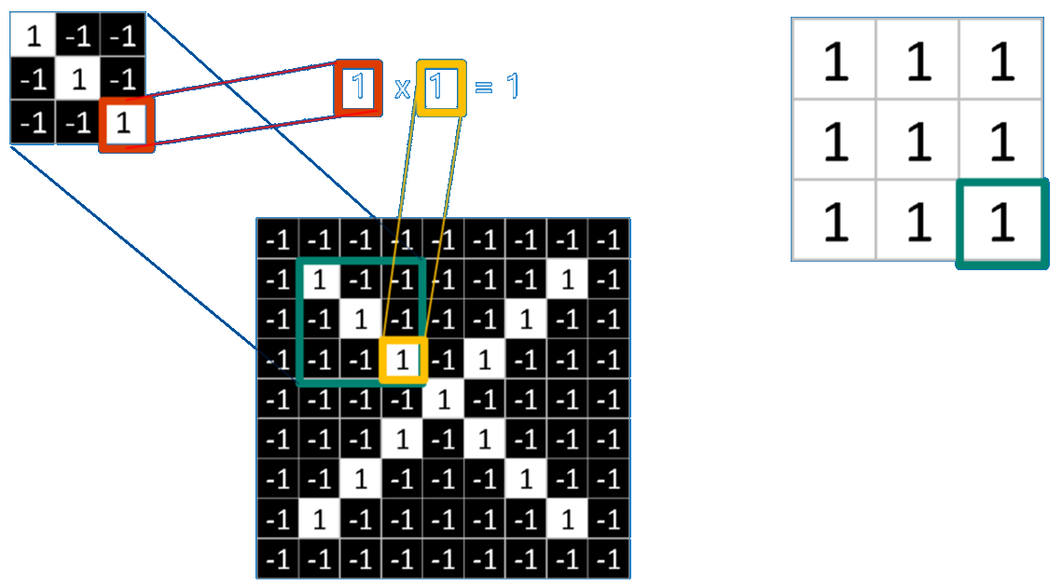

Slide 16
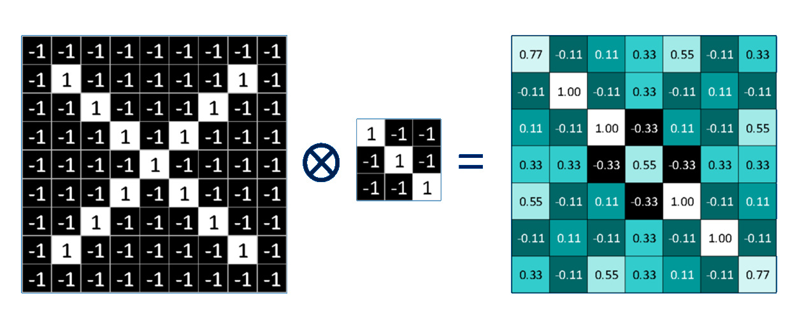

Slide 17
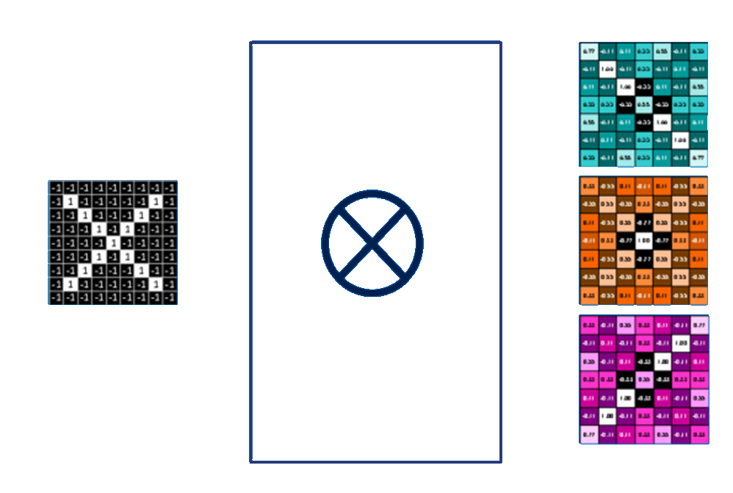

Slide 18
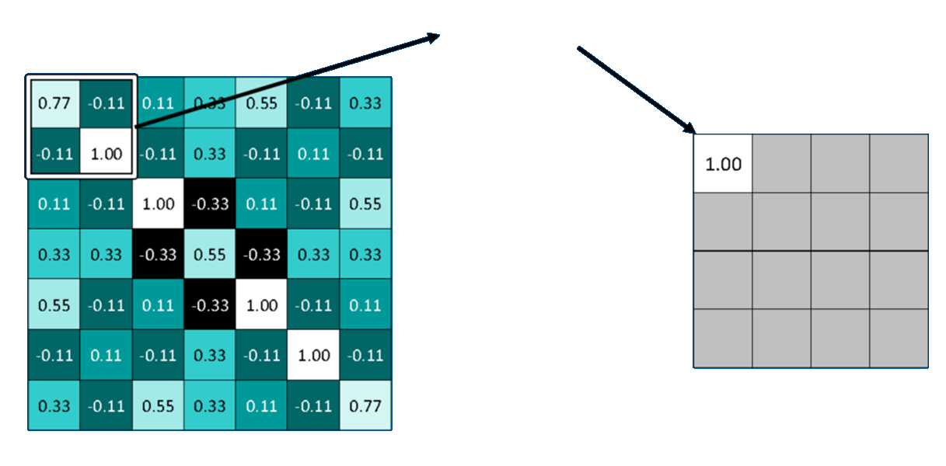
최대값

Slide 19
